Slide 1

Real-Time Network Intrusion Detection System (NIDS) using ML

Slide 2
CHAPTER 1: INTRODUCTION
Modern networks face growing cyber threats (DDoS, brute force,etc).
Traditional firewalls are insufficient—attacks often look like normal traffic.
NIDS monitors network traffic in real time to detect malicious activity.
ML-based NIDS improves accuracy, adapts to new attacks, and achieved ~99% detection.

Slide 3
PROBLEM STATEMENT & OBJECTIVES
Problem:
Cyberattacks increasing in frequency and complexity
Traditional IDS (signature-based) fail on new/unknown attacks
Manual detection is slow and inefficient
Objectives:
Detect and classify network intrusions (dos, portscan, bruteforce, bot, infiltration)
Analyze traffic features (IP, protocol, packet stats, severity)
Enable real-time detection and IP blocking
Visualize attack trends and performance metrics

Slide 4
CHAPTER 2: DATASET DESCRIPTION
Dataset: CICIDS2017
Originally developed by the Canadian Institute for Cybersecurity
Downloaded from Kaggle (open-source version for public use)
56,661 rows, 78 features
Benign + malicious traffic
Attack types: Dos, portscan, bruteforce, bot, webattack, infiltration
Key Features (Top 15 Selected)
Packet size statistics
Flow duration
TCP window bytes
Forward/backward packets
Active/idle times
Challenges
Class imbalance (rare attacks)
High dimensionality(78)
Dataset from 2017 (older threats)

Slide 5
CHAPTER 3: METHODS AND ALGORITHMS
Data Preprocessing
Handle missing/infinite values
Standardize numerical features (standardscaler)
Encode labels (labelencoder)
Feature selection using randomforest importance (top 15)
Models Used
Random forest (ensemble, robust, interpretable)
Lightgbm (boosting, high accuracy, fast)
Logistic regression (baseline model)
Evaluation Metrics
Accuracy
Precision / recall
F1 score
Confusion matrix

Slide 6
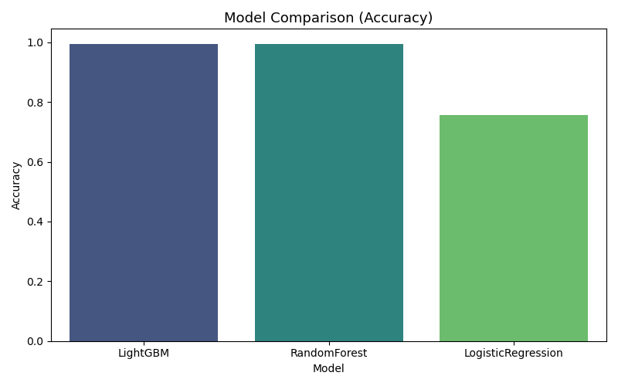
CHAPTER 4: PROJECT ANALYSIS
Models Comparison on the basic of accuracy:
Lightgbm ≈ 99.53%
Random forest ≈ 99.52%
Logistic regression ≈ 75%
Reason to select random forest:
Almost same accuracy as lightgbm
More stable and consistent performance
Better handling of class imbalance
Easier interpretation
More reliable in real-time deployment

Slide 7
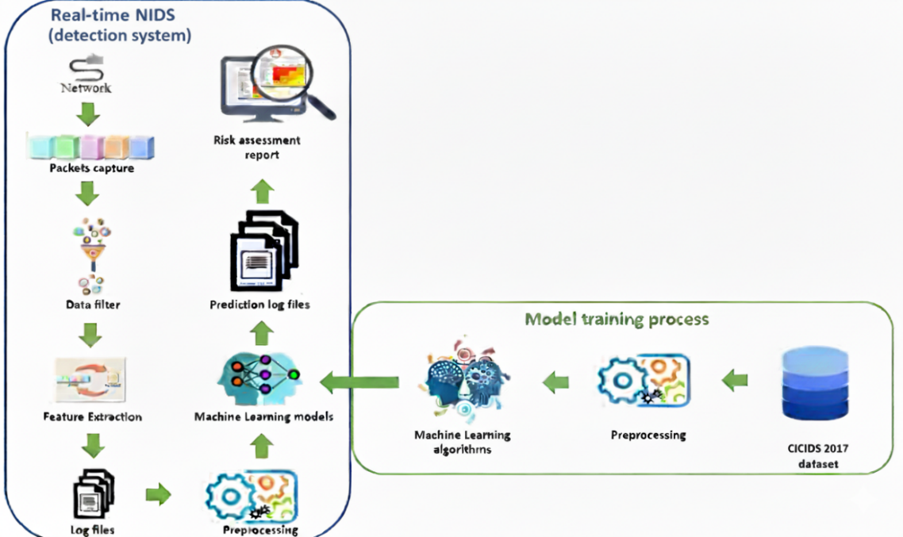
CHAPTER 5: FINAL RESULTS & SYSTEM WORKING
Real-Time Architecture:
System Working (Step-by-step):-
Capture live packets (PyShark)
Extract features (flow-level)
Scale & encode using saved scaler/encoder
Predict attack using RF model
Display on dashboard with severity
Option to block malicious IPs
Export logs / reports

Slide 8
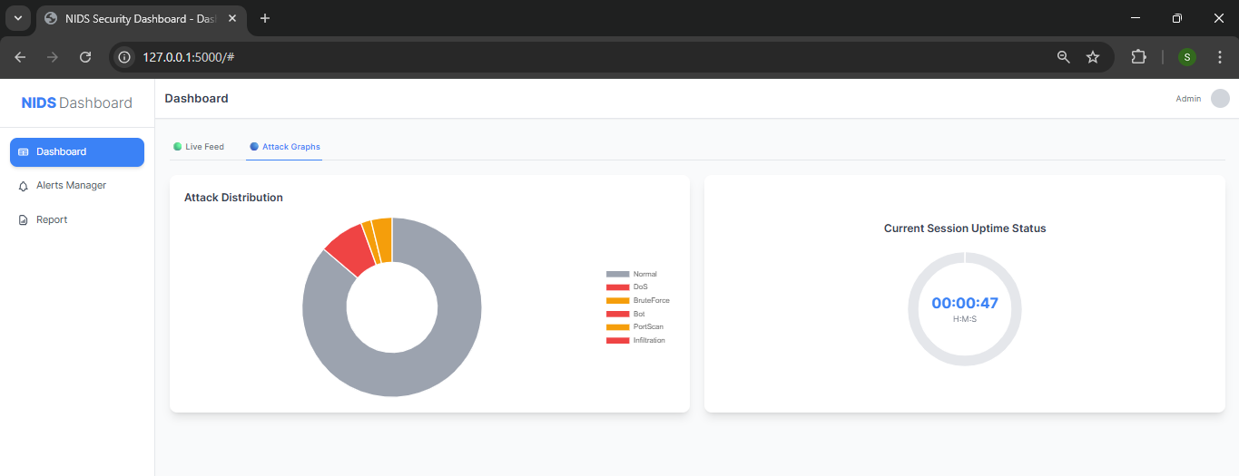
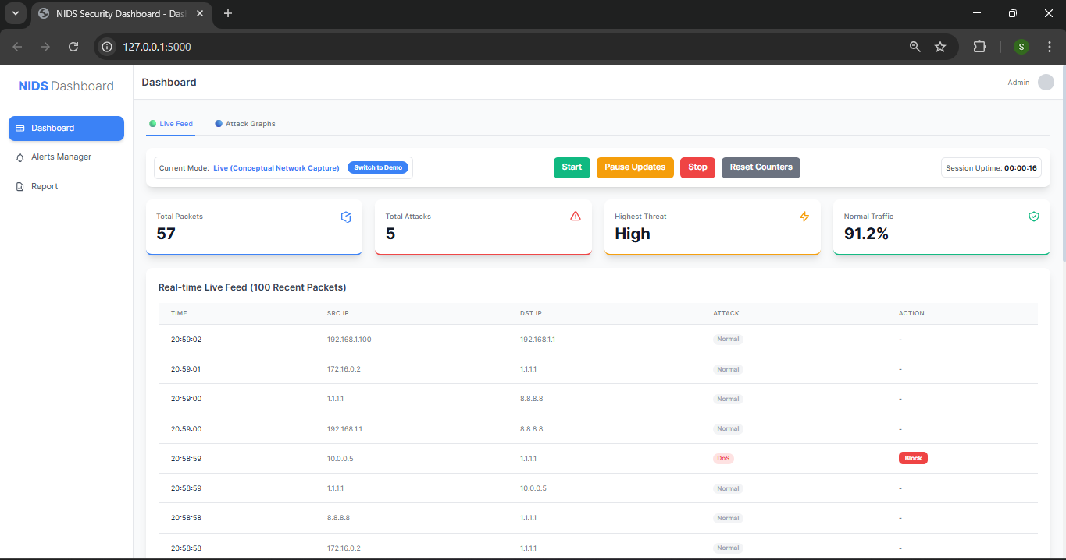
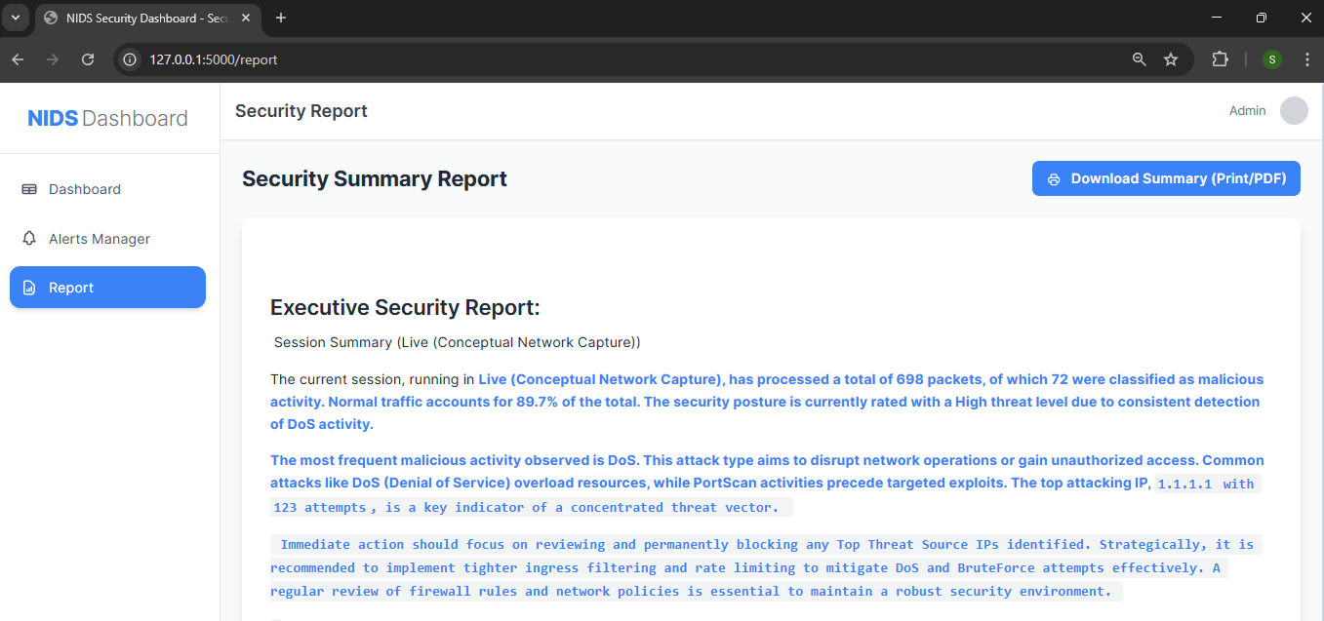
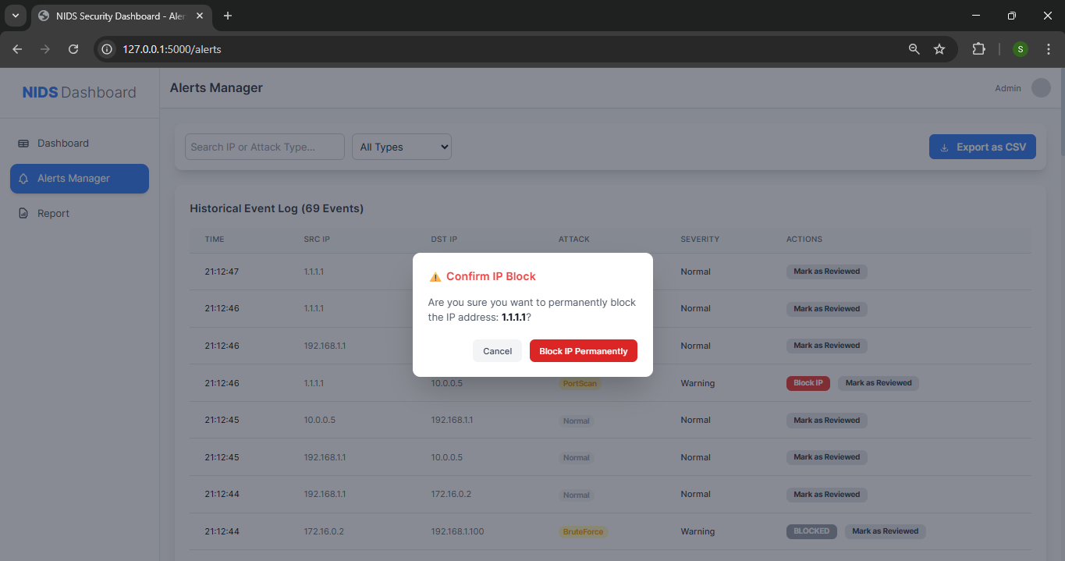
Real-Time Network Monitoring Dashboard
Attacks Distribution Graph and Count time
Main Dashboard to view all details
Security Summary Report
View all log of network to block the IP address of attacks

Slide 9
CONCLUSION & FUTURE SCOPE
Conclusion:-
ML-based NIDS can detect intrusions in real time
Random forest achieved ~99.5% accuracy
Flask dashboard improves monitoring & response
System helps to take quick actions
Future Scope:-
Integrate deep learning (autoencoders)
Adaptive learning from new attack data
Active prevention (real-time auto blocking)
Cloud-based NIDS for large-scale monitoring

